Slide 1
Credit Card Financial Analysis

Slide 2
Overview
"This project aims to analyze credit card transactions and customer data to uncover valuable insights. By integrating SQL for data storage and Power BI for visualization, I developed a dynamic dashboard that helps stakeholders track key financial metrics and optimize strategies. The key focus areas include revenue analysis, customer segmentation, and transaction trends."

Slide 3
Project Objective
"The primary objective of this project is to build a comprehensive dashboard that allows financial institutions to monitor key credit card metrics. By leveraging data analytics, we can identify spending patterns, customer preferences, and revenue-driving factors to enhance business performance."

Slide 4
Datasets Used
Customer Data - Includes demographics, income, ownership status, and customer satisfaction.
Credit Card Transactions - Contains transaction volumes, fees, credit limits, and interest earned.

Slide 5
Data Processing
Created tables in SQL
Imported into Power BI
Imported and cleaned Data in SQL

Slide 6
Created tables in SQL – Defined schemas for customer and transaction data.
Imported and cleaned data in SQL – Handled missing values and structured data for analysis.
Imported into Power BI – Performed transformations and used DAX functions for calculations.

Slide 7
Technologies Used
🛢 SQL - For data storage and querying.
📊 Power BI - For interactive visualizations and analytics.
📈 DAX Functions - To create calculated columns and measures for deeper insights.

Slide 8
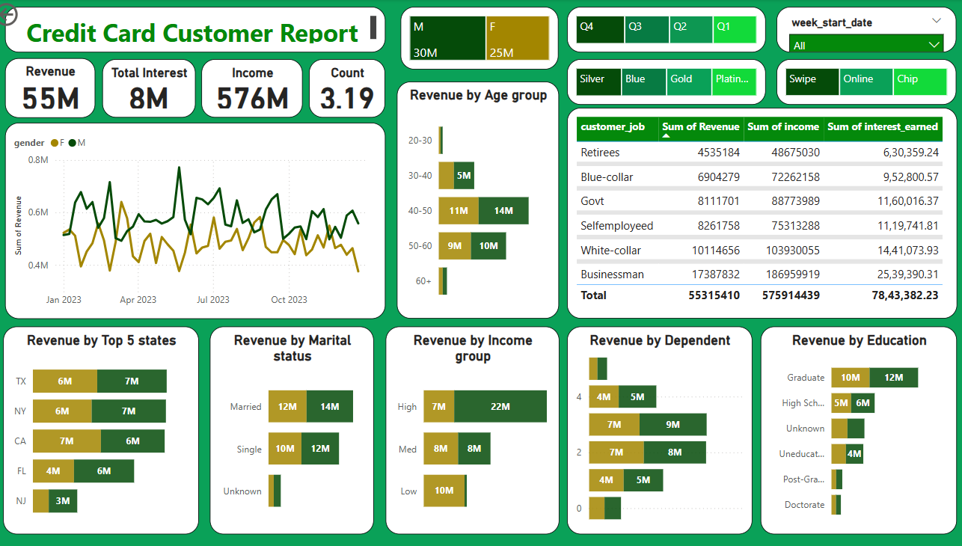
Dashboard

Slide 9
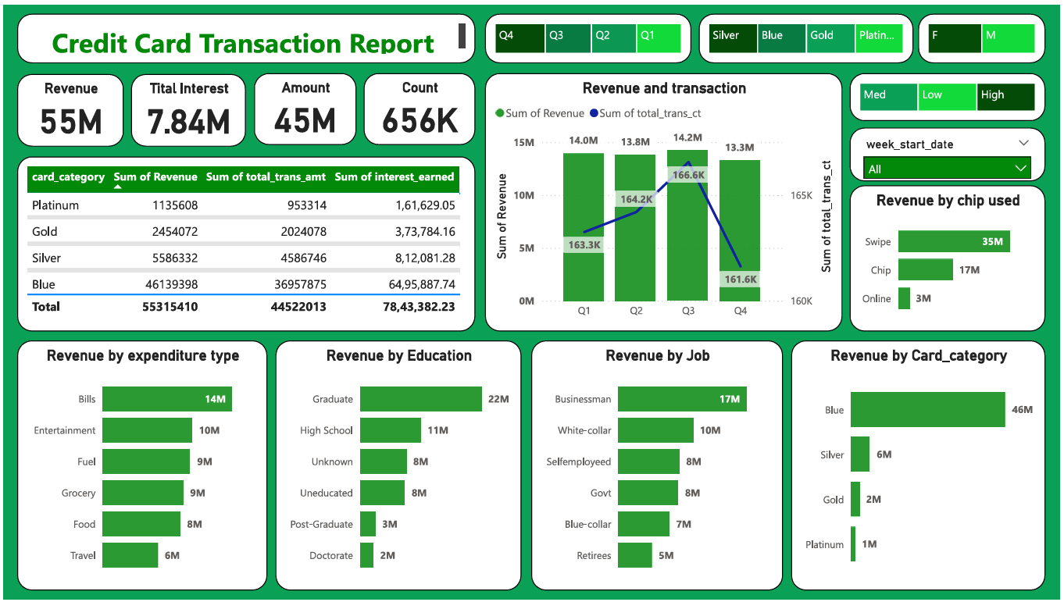

Slide 10
Dashboard Interaction :
Here is the link to interact with my dashboard
C:\Users\lenovo\Documents\Credit_card_financial_Dashboard.pbix
Github Link:
https://github.com/Shilpa2654/Credit-Card-Financial-Analysis

Slide 11
Dashboard Insights
📊 Revenue Breakdown - The Blue Card generates the highest revenue, contributing approximately 46M.
💳 Transaction Trends - Transactions using Swipe dominate spending patterns.
🔍 Customer Segments - Higher satisfaction among graduate and Businessman.
🛒 Expenditure Types - Most spending goes towards bills, entertainment, and fuel.

Slide 12
Recommendations
Optimize Credit Limits – Adjust limits based on customer spending behavior.
Target High-Value Customers – Offer premium services to high-income users.
Enhance Customer Engagement – Improve satisfaction with personalized rewards.
Monitor Transaction Fraud – Implement real-time anomaly detection for security.

Slide 13
🎯 Conclusion
This dashboard provides actionable insights into customer spending, helping banks and financial firms improve engagement and optimize credit offerings.

Slide 14
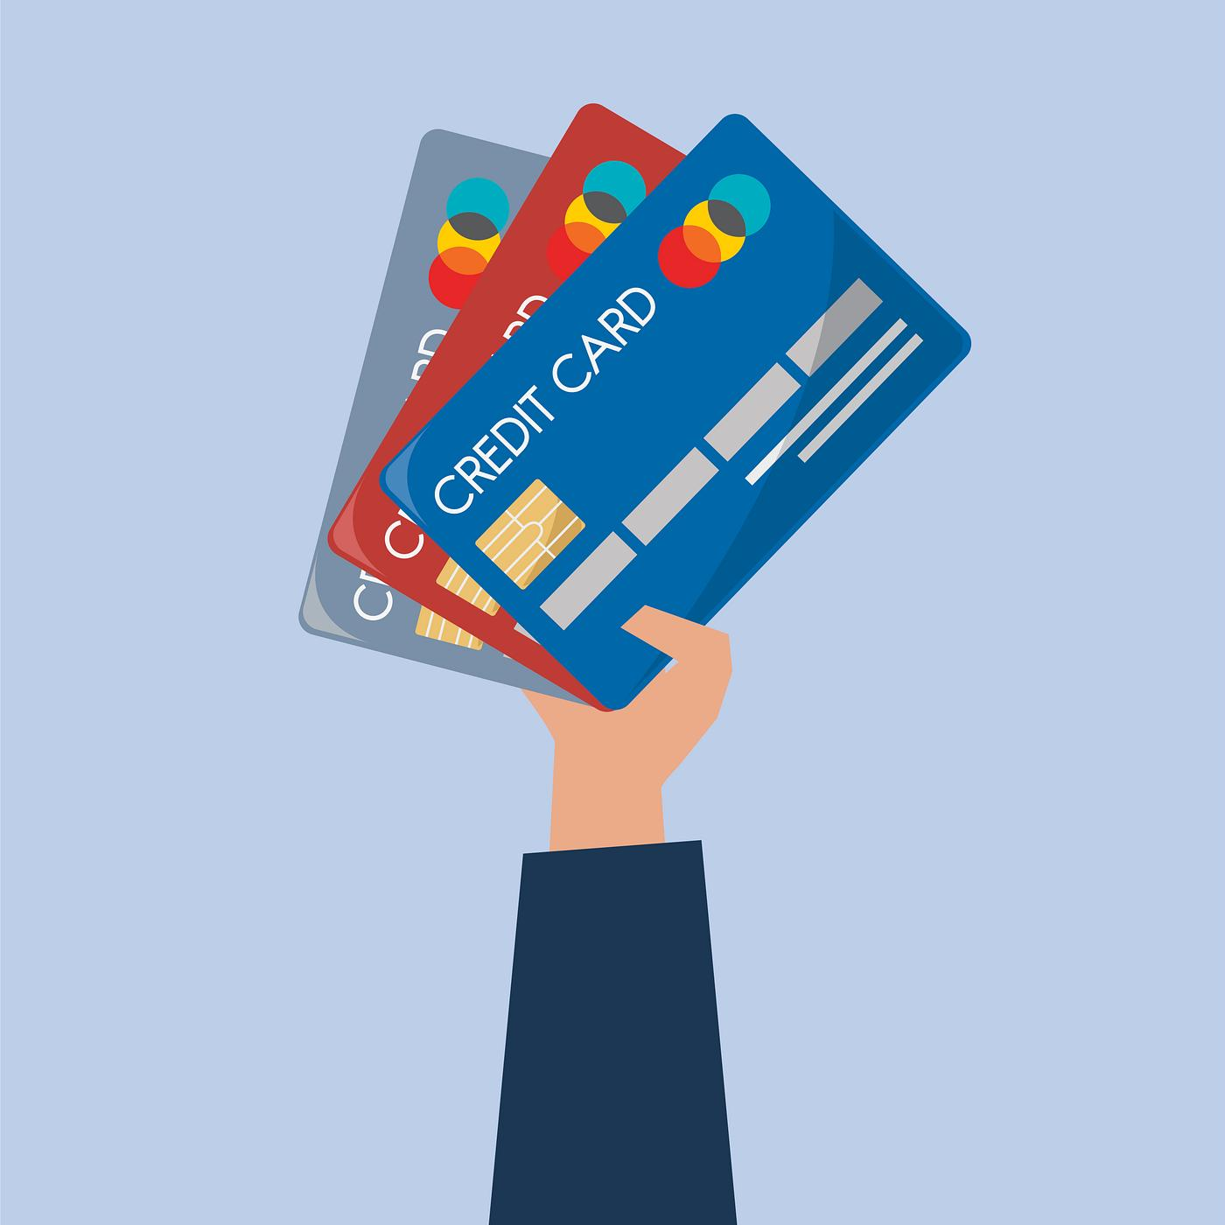
Thank You

